Slide 1
Solving SAT Problems
Dave Touretzky
(with some slides from Tuomas Sandholm)
Read Russell & Norvig Ch. 7.6-7.8

Slide 2
Overview
Satisfiability problems are CSPs with boolean variables. Solution techniques:
Truth table enumeration.
Theorem proving:
Today: Sophisticated model checking algorithms.

Slide 3
1. Truth Table Enumeration
A simple form of model checking. A formula
s is satisfiable if it has at least one model.
[(p ∧ ¬q) ∨ (q ∧ ¬p)] ⇒ r
P | Q | R
false | false | false
false | false | true
false | true | false
false | true | true
true | false | false
true | false | true
true | true | false
true | true | true
Possible
Models

Slide 4
2. Theorem Proving
Manipulate the constraints (formulae) by deriving new constraints.
Use the resolution inference rule.
Requires conjunctive normal form (CNF).
Works great for definite clauses:
One positive literal per clause.
Inference is purely modus ponens.
Can bog down if formulae are more complex.

Slide 5
Special Case: Definite Clauses
Definite clause: exactly one positive literal.
Horn clause: at most one positive literal.
Specialized algorithms exist for proving propositions from facts + definite clauses.
Forward chaining and backward chaining
The algorithms don’t explicitly do resolution, but they are consistent with the resolution rule.

Slide 6
Forward Chaining Algorithm
function PLC-FC-ENTAILS?(KB,q) returns true or false
inputs: KB, the knowledge base, a set of propositional definite clauses q, the query, a propositional symbol
count ← a table, where count[c] is initially the # of symbols in c’s premise
inferred ←a table, where inferred[s] is initially false for all symbols
agenda ←a queue of symbols, initially symbols known to be true in KB
while agenda is not empty do
p ←POP(agenda)
if p = q then return true
if inferred[p] = false then
inferred[p] ←true
for each clause c in KB where p is in c.PREMISE do
decrement count[c]
if count[c] = 0 then add c.CONCLUSION to agenda
return false

Slide 7
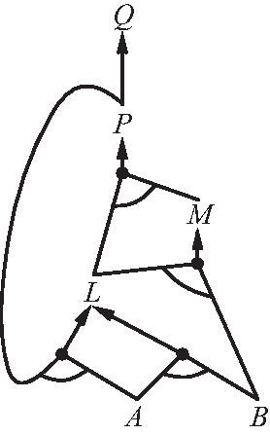
Forward Chaining: And/Or Graph
P ⇒ Q
L ∧ M ⇒ P
B ∧ L ⇒ M
A ∧ P ⇒ L
A ∧ B ⇒ L
A
B
Implications as definite clauses
Facts (initial agenda)

Slide 8
Backward Chaining Algorithm
Start with the goal proposition.
For all implications s that affirm the goal:
For all the premises p of s:
If p is given, continue.
If p is above us on the goal stack: next s.
Otherwise, recursively try to prove p; if failure, return false.
Return true.
Return false.

Slide 9
Backward Chaining: And/Or Graph
P ⇒ Q
L ∧ M ⇒ P
B ∧ L ⇒ M
A ∧ P ⇒ L
A ∧ B ⇒ L
A
B
Implications as definite clauses
Facts

Slide 10
3. Sophisticated Model Checking
Use CSP heuristic techniques to search the space of variable assignments.
We’ll consider two approaches:
Backtracking search: DPLL algorithm
Local search: WALK-SAT, GSAT, BREAKOUT

Slide 11
Davis-Putnam-Logemann-Loveland
(DPLL) Algorithm
Input is a sentence in CNF
Depth-first, backtracking enumeration of possible models, with three tricks:
1) Early termination
2) Pure symbol heuristic
3) Unit clause heuristic

Slide 12
Early Termination
A clause is true if any of its literals is true.
Can work with partial models; don’t have to wait for the remaining variables to be assigned.
A sentence is false if any clause is false.
Can avoid examination of entire subtrees in the search space.

Slide 13
Pure Symbol Heuristic
A pure symbol has the same sign in all clauses.
Ex: A and B are pure (and C is not) in:
(A ∨ ¬B), (¬B ∨ ¬C), (C ∨ A)
If a sentence has a model, then it has a model in which the pure symbols are assigned values that make their literals true.
Why? Because there are no opposite sign literals that could make any clause be false.

Slide 14
Symbols Can Become Pure
Symbols can become pure if some other literal is assigned a value that makes a clause true.
In that case, the symbol’s appearance in that clause can be ignored.

Slide 15
Unit Clause Heuristic
In DPLL, a unit clause is a clause in which all literals but one are already assigned false by the model.
Example: (¬B ∨ ¬C) when B = true.
This simplifies to ¬C, a unit clause.
So C must be false.
Now (C ∨ A) becomes a unit clause. This is called unit propagation.

Slide 16
function DPLL-SATISFIABLE?(s) returns true or false
inputs: s, a sentence in propositional logic
clauses ←the set of clauses in the CNF representation of s
symbols ←a list of the proposition symbols in s
return DPLL(clauses, symbols, {})
function DPLL(clauses, symbols, model) returns true or false
if every clause in clauses is true in model then return true
if some clause in clauses is false in model then return false
P, value ←FIND-PURE-SYMBOL(clauses, model)
if P is non-null then return DPLL(clauses, symbols - P, model ∪ {P=value})
P, value ←FIND-UNIT-CLAUSE(clauses, model)
if P is non-null then return DPLL(clauses, symbols - P, model ∪ {P=value})
P ←FIRST(symbols); rest ←REST(symbols)
return DPLL(clauses, rest, model ∪ {P=true}) or
DPLL(clauses, rest, model ∪ {P=false})
This is where the backtracking happens.

Slide 17
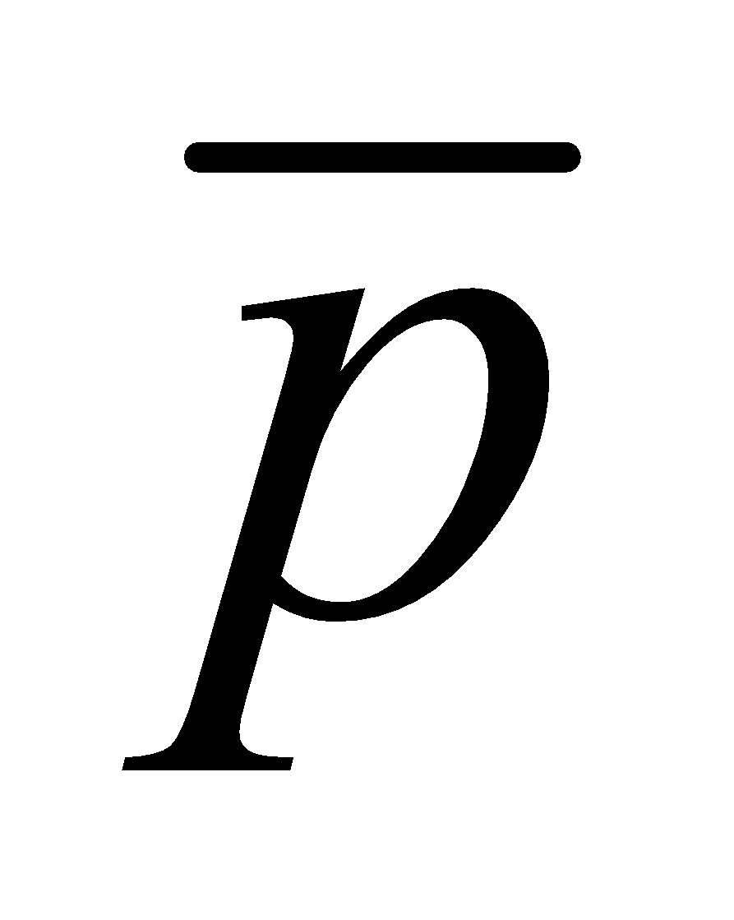
Davis-Putnam-Logemann-Loveland (DPLL) tree search algorithm
clause
E.g. for 3SAT
∃? s.t. (p₁∨¬p₃∨p₄) ∧ (¬p₁∨p₂∨¬p₃) ∧ …
Backtrack when some clause becomes empty
Unit propagation (for variable & value ordering): if some clause only has one literal left, assign that variable the value that satisfies the clause (never need to check the other branch)
Boolean Constraint Propagation (BCP): Iteratively apply unit propagation until there is no unit clause available
p₁
T
p₂
F
T
F
p₃
p₄
Complete

Slide 18
A helpful observation for the DPLL procedure
P₁ ∧ P₂ ∧ … ∧ P_{n} ⇒ Q (Horn)
is equivalent to
¬(P₁ ∧ P₂ ∧ … ∧ P_{n}) ∨ Q (Horn)
is equivalent to
¬P₁ ∨ ¬P₂ ∨ … ∨ ¬P_{n} ∨ Q (Horn clause)
Thrm. If a propositional theory consists only of Horn clauses (i.e., clauses that have at most one non-negated variable) and unit propagation does not result in an explicit contradiction (i.e., Pi and ¬Pi for some Pi), then the theory is satisfiable.
Proof. On the next page.
…so, Davis-Putnam algorithm does not need to branch on variables which only occur in Horn clauses

Slide 19
Proof of the theorem
Assume the theory is Horn, and that unit propagation has completed (without contradiction). We can remove all the clauses that were satisfied by the assignments that unit propagation made. From the unsatisfied clauses, we remove the variables that were assigned values by unit propagation. The remaining theory has the following two types of clauses that contain unassigned variables only:
¬P₁ ∨ ¬P₂ ∨ … ∨ ¬P_{n} ∨ Q and
¬P₁ ∨ ¬P₂ ∨ … ∨ ¬P_{n}
Each remaining clause has at least two variables (otherwise unit propagation would have applied to the clause). Therefore, each remaining clause has at least one negated variable. Therefore, we can satisfy all remaining clauses by assigning each remaining variable to False.

Slide 20
Variable ordering heuristic for DPLL [Crawford & Auton AAAI-93]
Heuristic: Pick a non-negated variable that occurs in a non-Horn (more than 1 non-negated variable) clause with a minimal number of non-negated variables.
Motivation: This is effectively a “most constrained first” heuristic if we view each non-Horn clause as a “variable” that has to be satisfied by setting one of its non-negated variables to True. In that view, the branching factor is the number of non-negated variables the clause contains.

Slide 21
Variable ordering heuristic for DPLL
Q: Why is branching constrained to non-negated variables?
A: We can ignore any negated variables in the non-Horn clauses because
whenever any one of the non-negated variables is set to True the clause becomes redundant (satisfied), and
whenever all but one of the non-negated variables is set to False the clause becomes Horn.
Variable ordering heuristics can make several orders of magnitude difference in speed.

Slide 22
Beyond DPLL
State of the art SAT solvers can handle expressions with tens of millions of variables.
Used in applications such as VLSI chip verification.
How do they do it?
More heuristics!

Slide 23
SAT Solver Heuristics
Component analysis: variables that appear in disjoint sets of clauses can be separated and the subproblems solved independently.
Variable and value ordering. The degree heuristic suggests choosing the variable that appears most frequently over all remaining clauses.

Slide 24
SAT Solver Heuristics
Intelligent backtracking: jump back far enough to reach a variable responsible for the failure.
Conflict clause learning can record conflicts so they won’t be repeated later.
Random restarts if a run appears not to be making progress allow different choices of variables and values. Learned conflict clauses are retained.

Slide 25
SAT Solver Heuristics
Clever indexing provides fast access to things such as “the set of clauses in which the variable X_{i} appears as a positive literal.”
Must be computed dynamically because we only care about clauses that have not yet been satisfied.

Slide 26
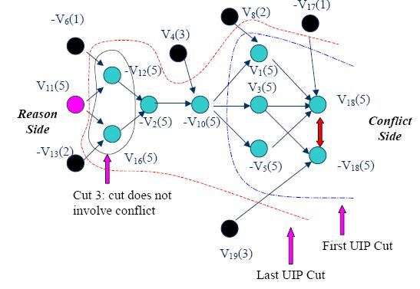
Constraint learning aka nogood learning aka clause learning used by state-of-the-art SAT solvers
Conflict graph
Nodes are literals
Number in parens shows the search tree level where that node got decided or implied
Which cuts should we use?
Any cut that separates the conflict from the reasons would give a valid clause.
Clause from first-unique-implication-point (1UIP) cut is (v10 or -v8 or v17 or -v19).
1UIP scheme performs well in practice.
The learned clauses apply to all other parts of the tree as well.
Should we delete some clauses at some point?

Slide 27
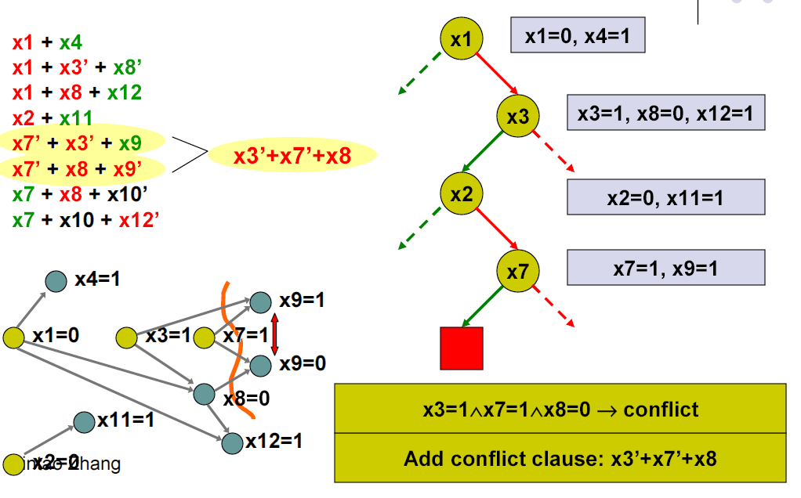
Clause learning (aka nogood learning) (used by state-of-the-art SAT solvers)
Dotted
arrows
not
explored
yet
Conflict graph:
x2=0
Which cut(s) should we use?
Any cut that separates the conflict from the yellow reason nodes would give a valid clause.
Clause from first-unique-implication-point (1UIP) cut is shown here.
1UIP scheme performs well in practice.
The learned clauses apply to all other parts of the tree.
Should we delete some clauses at some point?

Slide 28
Conflict-directed backjumping (A step-by-step walk-through of this example is also at https://en.wikipedia.org/wiki/Conflict-Driven_Clause_Learning)
Dotted
arrows
not
explored
yet
x7=0
Failure-driven assertion (not a branching decision):
Learned clause is a unit clause under this path, so
BCP automatically sets x7=0.
x2=0
Then backjump to the decision level of x3=1,
keeping x3=1 (for now), and
forcing the implied fact x7=0 for that x3=1 branch
WHAT’S THE POINT? A: No need to just backtrack to x2

Slide 29
Classic readings on conflict-directed backjumping, clause learning, and heuristics for SAT
“GRASP: A Search Algorithm for Propositional Satisfiability”, Marques-Silva & Sakallah, IEEE Trans. Computers, C-48, 5:506-521,1999. (Conference version 1996.)
(“Using CSP look-back techniques to solve real world SAT instances”, Bayardo & Schrag, Proc. AAAI, pp. 203-208, 1997)
“Chaff: Engineering an Efficient SAT Solver”, Moskewicz, Madigan, Zhao, Zhang & Malik, 2001 (www.princeton.edu/~chaff/publication/DAC2001v56.pdf)
“BerkMin: A Fast and Robust Sat-Solver”, Goldberg & Novikov, Proc. DATE 2002, pp. 142-149
See also slides at http://www.princeton.edu/~sharad/CMUSATSeminar.pdf

Slide 30
Generalizing backjumping from SAT to CSPs

Slide 31
Basic backjumping in CSPs
Conflict set of a variable: all previously assigned variables connected to that variable by at least one constraint
When the search reaches a variable V with no legal values remaining, backjump to the most recently assigned variable in V’s conflict set
Conflict set is updated while trying to find a legal value for the variable
Vertex C has no legal values left!
The search backjumps to the most recent vertex in its conflict set:
Un-assigns value to B, un-assigns value to A
Retries a new value at A
If no values left at A, backjump to most recent node in A’s conflict set, etc.
search path
Values(A) = {R,B}
A
Values(B) = {R,B}
Values(B) = {B}
B
C
Conflicts(C) = {}
Conflicts(C) = {A=R}
Values(C) = {R}
Values(C) = {}
Every branch pruned by basic backjumping is also pruned by forward checking

Slide 32
Conflict-directed backjumping in CSPs
Basic backjumping isn’t very powerful:
Consider the partial assignment {WA=red, NSW=red}
Suppose we set T=red next
Then we assign NT, Q, V, SA
We know no assignment can work for these, so eventually we run out of values for NT
Where to backjump?
Basic backjumping wouldn’t work, i.e., we’d just backtrack to T (because NT doesn’t have a complete conflict set with the preceding assignments: it does have values available)
But we know that NT, Q, V, SA, taken together, failed because of a set of preceding variables, which must be those variables that directly conflict with the four
=> Deeper notion of conflict set: it is the set of preceding variables (WA and NSW) that caused NT, together with any subsequent variables, to have no consistent solution
We should backjump to NSW and skip over T.
Conflict-directed backjumping (CBJ):
Let X_{j} be the current variable, and conf(X_{j}) its conflict set. We exhaust all values for X_{j}.
Backjump to the most recently assigned variable in conf(X_{j}), denoted X_{i}.
Set conf(X_{i}) = conf(X_{i}) ∪ conf(X_{j}) – {X_{i}}
If we need to backjump from X_{i} , repeat this process.
Study this example step by step from Russell & Norvig Chapter 6.
WA
NSW
T
NT
Q
V
SA

Slide 33
Nogood learning in CSPs
Conflict-directed backjumping computes a set of variables and values that, when assigned in unison, creates a conflict
It is usually the case that only a subset of this conflict set is sufficient for causing infeasibility
Idea: Find a small set of variables from the conflict set that causes infeasibility
We can forbid this combination by adding a new constraint to the problem or putting it in a dynamic nogood pool
Useful for guiding future search paths away from similar problem (i.e., guaranteed infeasible) areas of the search space
Conflict sets are either local or global:
Global: If this subset of variables have these certain values, the problem is always infeasible
Local: Constraint is only valid for a certain subset of search space

Slide 34
Advanced topic: More on conflict-directed backjumping (CBJ)
and nogood learning
These are for general CSPs, not SAT specifically:
“Conflict-directed backjumping revisited” by Chen and van Beek, Journal of AI Research, 14, 53-81, 2001:
As the level of local consistency checking (lookahead) is increased, CBJ becomes less helpful
A dynamic variable ordering exists that makes CBJ redundant
Nevertheless, adding CBJ to backtracking search that maintains generalized arc consistency leads to orders of magnitude speed improvement experimentally
“Generalized NoGoods in CSPs” by Katsirelos & Bacchus, National Conference on Artificial Intelligence (AAAI-2005) pages 390-396, 2005
Generalized nogoods so that they can express nogoods to contain either assignments or non-assignments
Then nogood learning can speed up (even non-SAT) CSPs significantly
“An optimal coarse-grained arc consistency algorithm” by Bessiere et al. Artificial Intelligence, 2005
Fastest CSP solver at the time; uses generalized arc consistence and no CBJ

Slide 35
Random restarts

Slide 36
Random restarts
Sometimes it makes sense to keep restarting the CSP/SAT algorithm, using randomization in variable ordering [see, e.g., work by Carla Gomes et al.]
Avoids the very long run times of unlucky variable ordering
On many problems, yields faster algorithms
Heavy-tailed runtime distribution is a sufficient condition for this
All good complete SAT solvers use random restarts nowadays
Clauses learned can be carried over across restarts
Experiments suggest it does not help on optimization problems (e.g., [Sandholm et al. IJCAI-01, Management Science 2006])
When to restart?
If there were a known runtime distribution, there would be one optimal restart time (i.e., time between restarts). Denote by R the resulting expected total runtime
In practice the distribution is not known. Luby-Sinclair-Zuckerman [1993] restart scheme (1,1,2,1,1,2,4, 1,1,2,1,1,2,4,8,…) achieves expected runtime ≤ R(192 log(R) + 5)
Useful, and used, in practice
The theorem was derived for independent runs, but here the nogood database (and the upper and lower bounds on the objective in case of optimization) can be carried over from one run to the next

Slide 37
Phase transitions in CSPs

Slide 38
“Order parameter” for 3SAT [Mitchell, Selman, Levesque AAAI-92]
β = #clauses / # variables
This predicts
satisfiability
hardness of finding a model

Slide 39
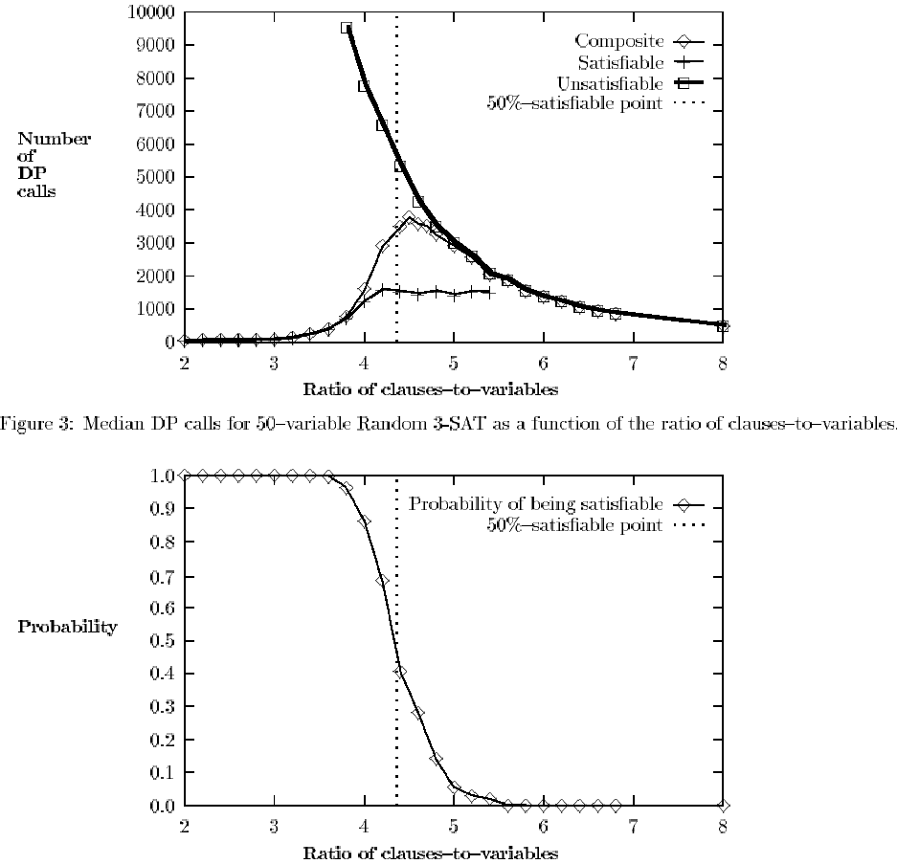

Slide 40
How would you capitalize on the phase transition in an algorithm?

Slide 41
Generality of the order parameter β
The results seem quite general across model finding algorithms
Other constraint satisfaction problems have order parameters as well

Slide 42
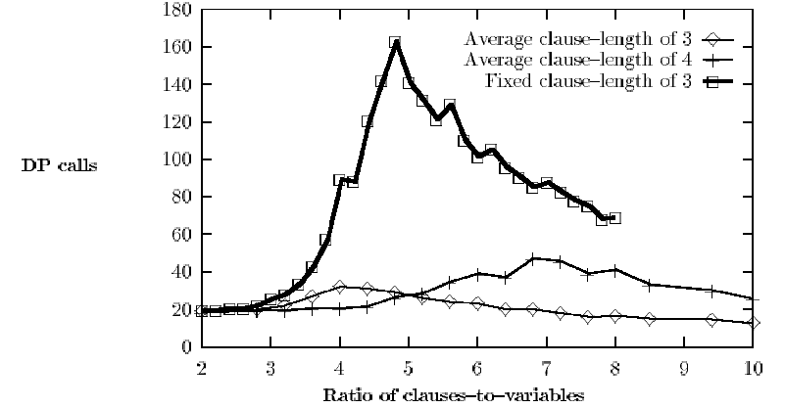
…but the complexity peak does not occur (at least not in the same place) under all ways of generating SAT instances

Slide 43
Iterative refinement (local search) algorithms for SAT

Slide 44
WALKSAT
function WALKSAT(clauses, p, max_flips) returns a model or failure
inputs: clauses, a set of clauses in propositional logic
p, the probability of choosing to do a random walk, typically around 0.5
max_flips, number of flips allowed before giving up
model ← a random assignment of true/false to the symbols in clauses
for i = 1 to max_flips do
if model satisfies clauses then return model
clause ←a randomly selected clause from clauses that is false in model
with probability p flip the value in model of a randomly selected symbol from clause
else flip whichever symbol in clause maximizes the # of satisfied clauses
return failure

Slide 45
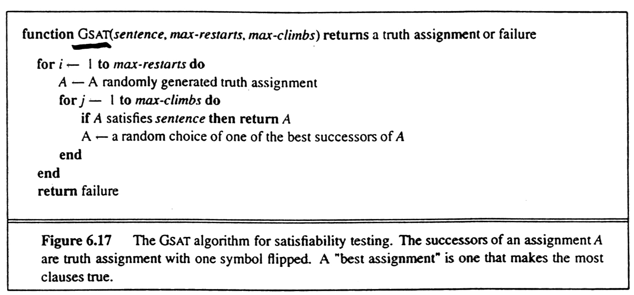
GSAT [Selman, Levesque, Mitchell AAAI-92] (= a local search algorithm for model finding)
Incomplete (unless restart a lot)
Avg. total flips
2000
1600
1200
800
400
50 variables, 215 3SAT clauses
Greediness is not essential as long as climbs and sideways moves are preferred over downward moves.
max-climbs
100 200

Slide 46
BREAKOUT algorithm [Morris AAAI-93]
Initialize all variables P_{i} randomly
UNTIL current state is a solution
IF current state is not a local minimum
THEN make any local change that reduces the total cost (i.e., flip one P_{i})
ELSE increase weights of all unsatisfied clauses by one
Incomplete, but very efficient on large (easy) satisfiable problems.
Reason for incompleteness: the cost increase of the current local optimum spills over to other solutions because they share unsatisfied clauses.

Slide 47
Summary of the algorithms we covered for inference in propositional logic
Truth table method
Inference rules, e.g., resolution
Model finding algorithms
Davis-Putnam (Systematic backtracking)
Early backtracking when a clause is empty
Unit propagation
Variable (& value?) ordering heuristics
Local search
WALKSAT
GSAT
BREAKOUT

